Slide 1
The Complexity of JPA
2023-08-21
Jens Schauder (He/Him)Him)
Spring Data Commiter

Slide 2
I don’t give guarantees!
I was surprised at times as well.

Slide 3
Does EntityManager.persist save an entity to the database?
Yes.
No.
It depends.

Slide 4
Does EntityManager.persist save an entity to the database?
persist adds an entity to the persistence context. For this it needs an id.
This might enforce an insert statement.

Slide 5
Does EntityManager.find load an entity from the database?
Yes.
No.
It depends.

Slide 6
Does EntityManager.find load an entity from the database?
find returns an entity from the persistence context. Only if the entity doesn’t exist there it will be loaded from the database.

Slide 7
Does a query load entities from the database?
Yes.
No.
It’s complicated.

Slide 8
Does a query load entities from the database?
A query gets executed against the database. But if a returned entity is already in the persistence context, that instance will be returned. New data from the database will be ignored.

Slide 9
A has a list of B and a version attribute. If you change, remove or add a B, does the version of A change?
Yes.
No.
It’s complicated.

Slide 10
Updates to the collection trigger a version update. Updates to the element of the collections don’t.

Slide 11
Can you use Java Records for entities?
Yes.
No.
It depends.

Slide 12

But Why?

Slide 13
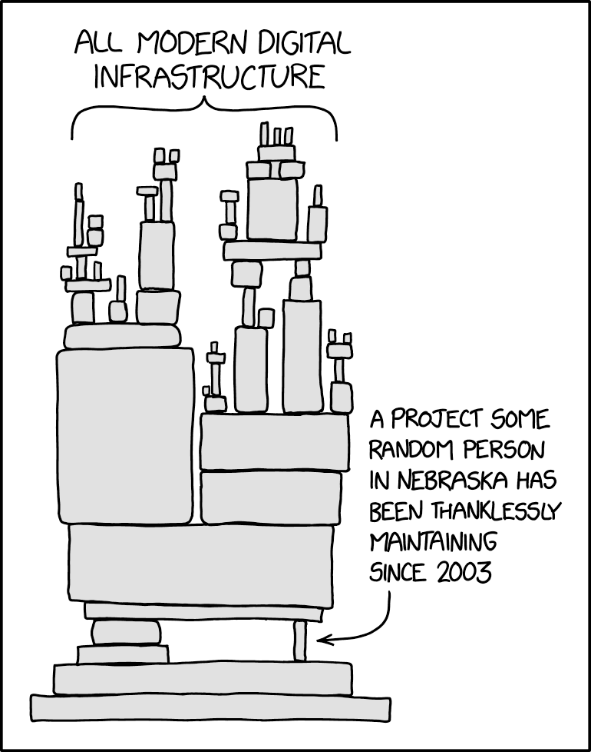
The Foundation
https://xkcd.com/2347

Slide 14
The Root Problem
All of JPA
Dirty Tracking

Slide 15

Dirty Tracking
https://unsplash.com/photos/qkTf-r5iZpE

Slide 16

Single Instance

Slide 17
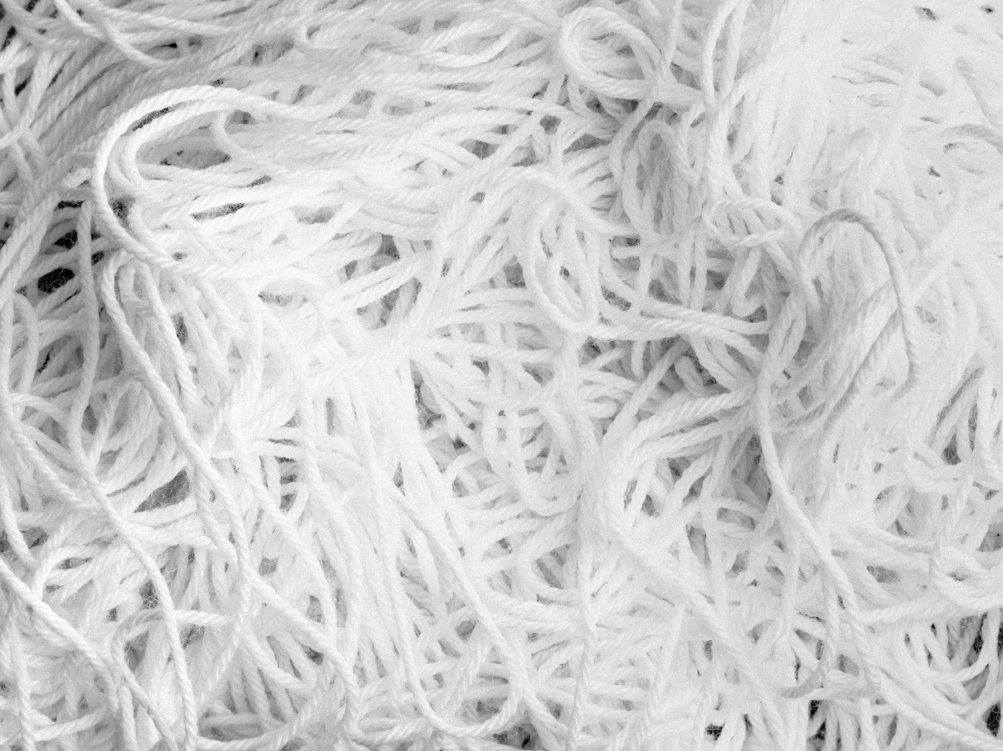
Single Instance of Everything
https://unsplash.com/photos/zyQ9_ylaAfg

Slide 18
Caching Instances
There are two hard problems:
1. Cache invalidation.
2. Naming things.
3. Off-by-one-errors.

Slide 19

No Clear Boundaries
https://unsplash.com/photos/wv81LrAGNz4

Slide 20

Spring Data JDBC
https://unsplash.com/photos/x2Tmfd1-SgA

Slide 21
Entities are
Not proxied.
Not cached.
Loaded asked for.
Saved when save is called.

Slide 22
Entities are
Grouped into Aggregates.

